Slide 1


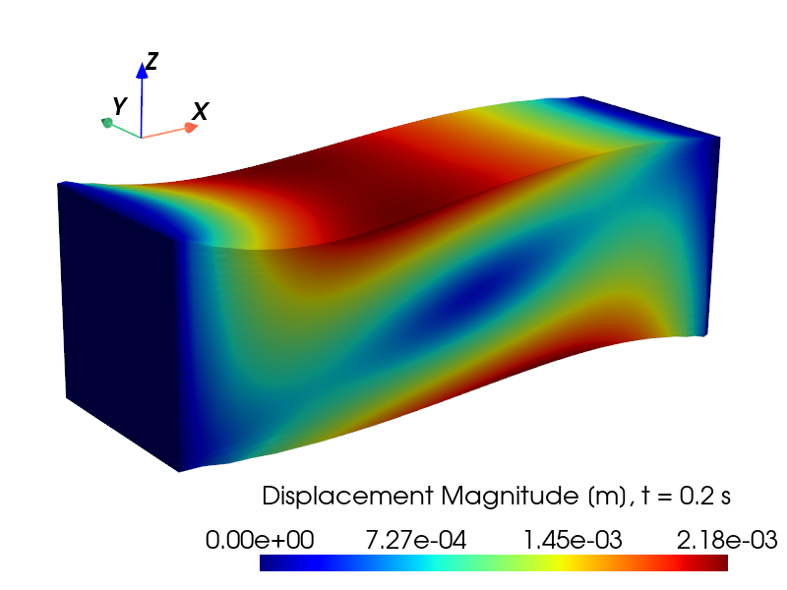
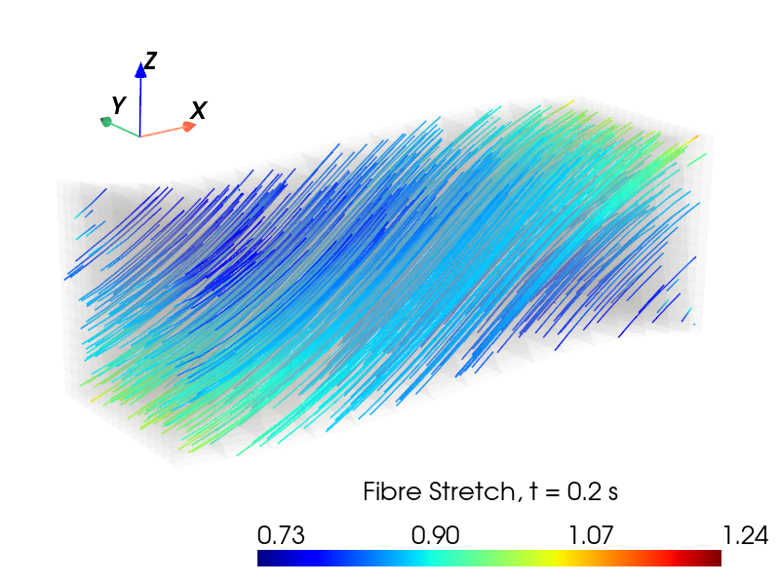
Tutorial 1: Introduction to the Flexodeal Framework
Javier Almonacid
Research Assistant @ NML
February 27, 2026

Slide 2
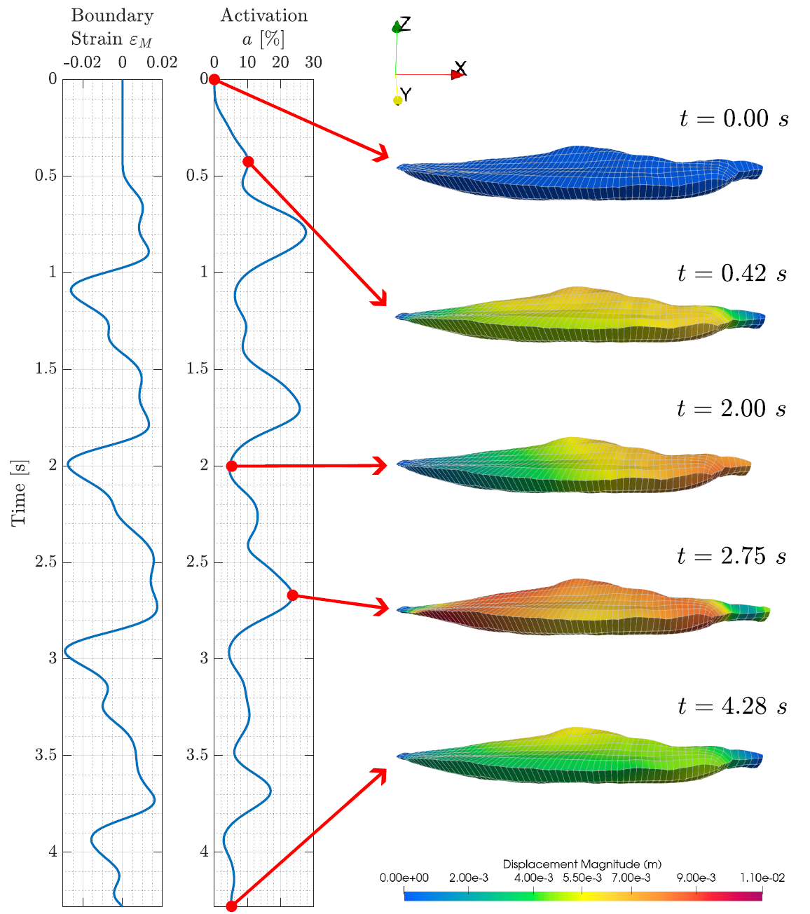
What is Flexodeal?
It is a computational framework developed by the NML to simulate the dynamic deformation of active muscle tissue in 3D based on commonly-accepted physiological principles.
Written in C++, powered by deal.II.
Discretization based on finite elements.
Geometries are meshed using hexahedral elements (voxels).

Slide 3
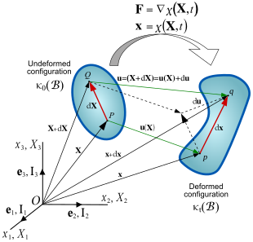
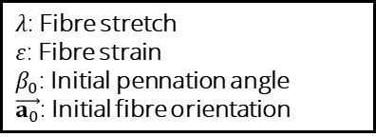
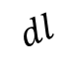
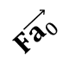
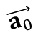
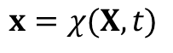
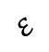
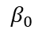
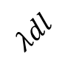
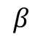
Main Features
Local minimization of the total energy leads to a system of nonlinear PDEs in a three-field formulation (Simo et al. 1985).
Stress modelled as the additive response of:
An along-fibre component (Hill’s model),
Base material,
Intramuscular fat,
Tendon,
Aponeurosis.
Deformation
tensor
$$F\vec{a_{0}}$$
$λ$: Fibre stretch
$ε$: Fibre strain
$β_{0}$: Initial pennation angle
$\vec{a_{0}}$: Initial fibre orientation
$$λdl$$
$$ε$$
$$dl$$
$$\vec{a_{0}}$$
$$β_{0}$$
$$β$$
Line of action
Undeformed
configuration
$$x=χ(X,t)$$
Deformed
configuration
3

Slide 4
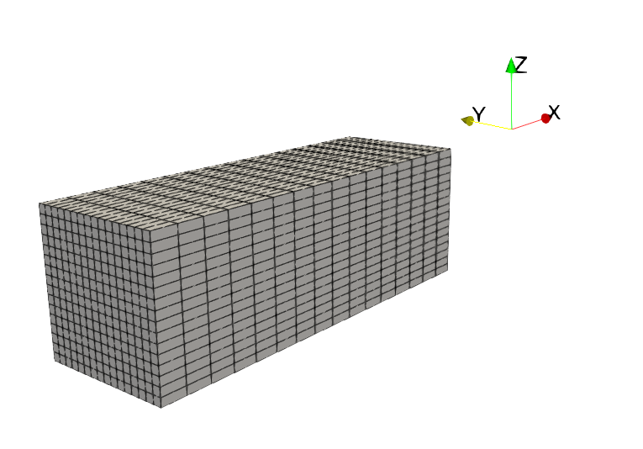
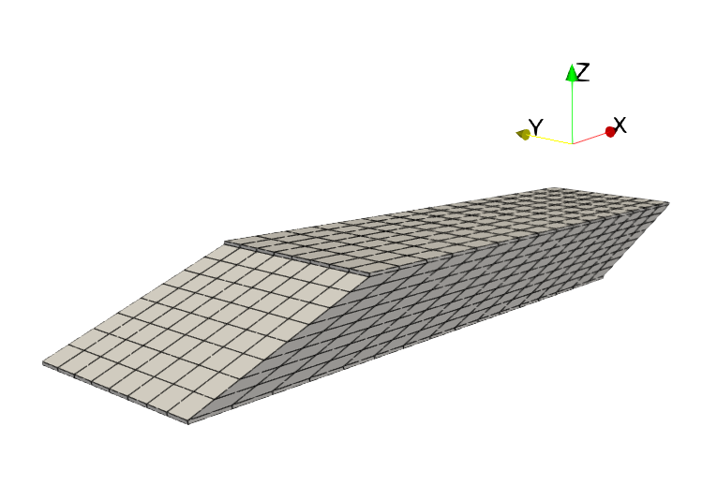
Available in two versions
Flexodeal Lite (Tutorial 1) github.com/sfu-nml/flexodeal-lite
A simpler code suitable for numerical developments or simple experiments.
Supports muscle tissue only (no tendon or aponeurosis).
Fat-free muscle (by default).
Default geometry: cuboid.
Flexodeal (Tutorial 2) github.com/sfu-nml/flexodeal
A more complex code suitable for realistic experiments of the muscle-tendon unit.
Support muscle tissue, tendon, and aponeurosis.
Spatially-variable intramuscular fat.
Spatially-variable initial fibre orientations.
Default geometry: idealized MG.
Ross, S. A., Domínguez, S., Nigam, N., & Wakeling, J. M. (2021). The energy of muscle contraction. III. Kinetic energy during cyclic contractions. Frontiers in physiology, 12, 628819

Slide 5
Downloading and compiling Flexodeal Lite
Description | UNIX Command
Download the latest release of Flexodeal Lite from: https://github.com/sfu-nml/flexodeal-lite/releases | wget https://github.com/sfu-nml/flexodeal-lite/archive/refs/tags/v1.6.1.zip
Unzip the downloaded file | unzip v1.6.1.zip
Navigate to the flexodeal-lite-1.6.1 folder | cd flexodeal-lite-1.6.1
Compile the software | cmake . –DCMAKE_BUILD_TYPE=Release –DDEAL_II_DIR=<path/to/deal.II>
Call “make” | make
If ”make” was successful, you should now have an executable called “flexodeal-lite”. | ./flexodeal-lite

Slide 6
The default experiment

Slide 7
How to set up a computational experiment?
In the Flexodeal framework, we follow the principles of computational mechanics.
To set an experiment, you will need:
A mesh of your geometry (computational domain).
Model and simulation (numerical) parameters.
A time-dependent boundary strain -> this controls the length of the muscle.
A time-dependent activation profile.
We will go over the details of the default experiment in Flexodeal Lite, i.e. the one you obtain when simply running in your terminal:
./flexodeal-lite.

Slide 8
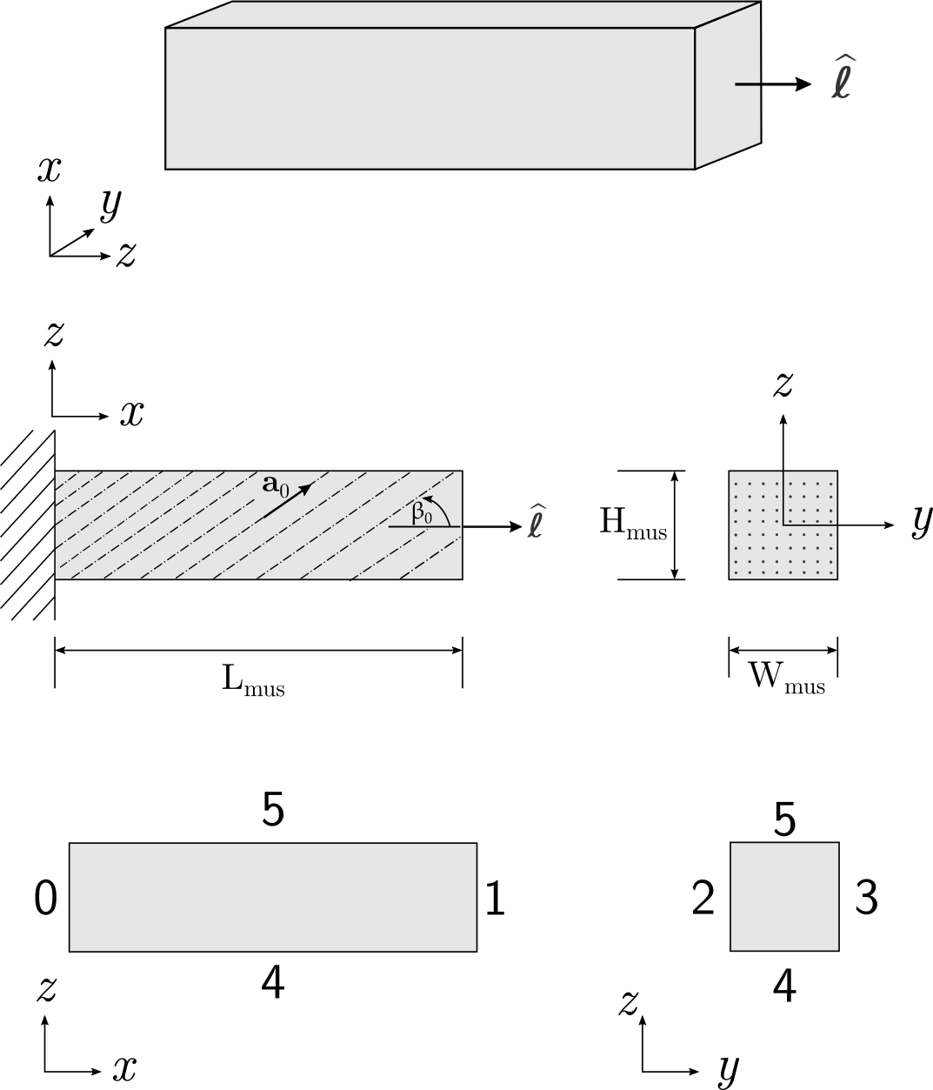
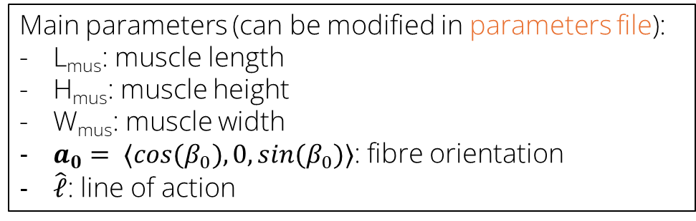
Geometry (computational domain)
3D view. Geometry contains muscle tissue only (no aponeurosis or tendon).
Main parameters (can be modified in parameters file):
L_{mus}: muscle length
H_{mus}: muscle height
W_{mus}: muscle width
$a_{0}= 〈cos(β_{0}),0,sin(β_{0})〉$: fibre orientation
$\hat{ℓ}$: line of action
Boundary IDs:
0: Fixed (no displacement)
1: Moving boundary (prescribed strain)
2-5: Traction free.

Slide 9
Parameters file
A file with extension .prm containing several model and simulation parameters.
Some important parameters in this file are:
Type of simulation (dynamic or quasi-static),
Simulation time and time step size,
Muscle block dimensions,
Fibre orientations,
Markers (to track selected point displacements),
Solver type (“Direct” for coarse meshes, “CG” for finer meshes),
Error tolerances.
Open the parameters.prm file to see the complete list of parameters.

Slide 10
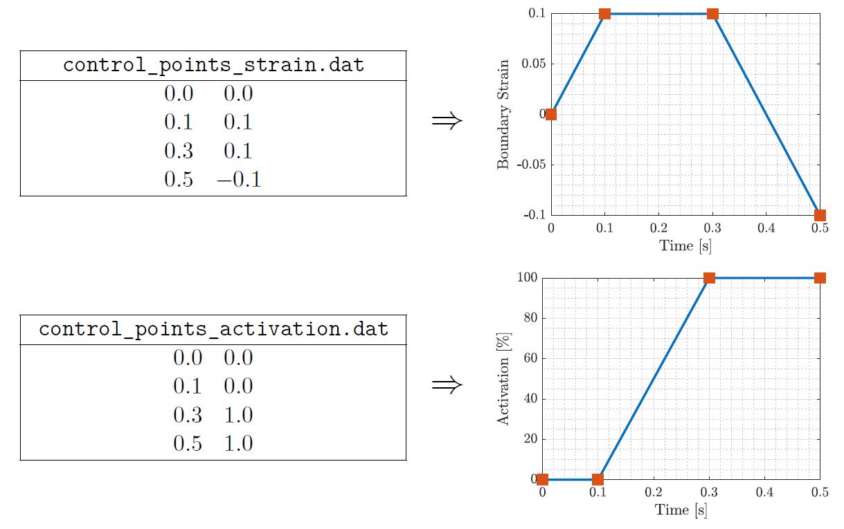
Boundary strain and activation files
Strain
(e.g., 0.1 = 10% strain = lengthen muscle to 1.1L_{mus}
They provide the time-dependent prescribed boundary strain (on boundary ID 1 for the default experiment) and the time-dependent activation profile to the simulation.
Each file is a table of coordinate pairs.
Flexodeal uses linear interpolation to evaluate these functions between control points.
Time
(in seconds)
Activation
(e.g., 0.5 = 50%, 1.0 = 100%)

Slide 11
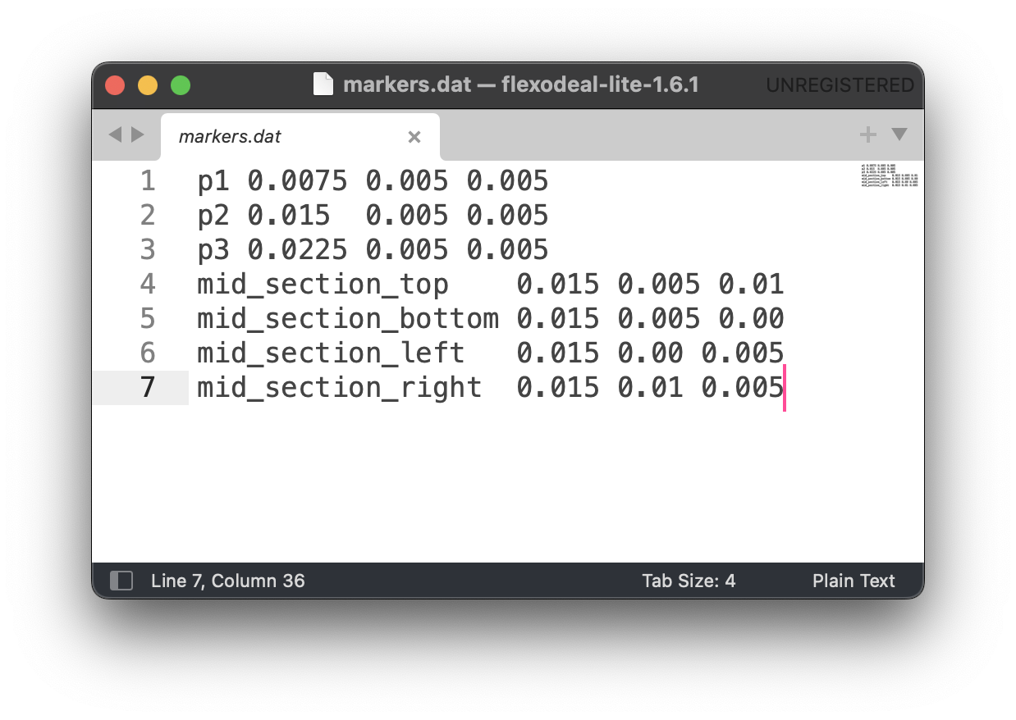
Markers (displacement trackers, optional)
Although the entire 3D displacement field is available as a VTU file, we can also track this variable at point locations in the mesh.
Markers must correspond to mesh vertices.
If you do not require this feature, this file can be left empty.
Marker’s name
X, Y, and Z coordinates of the point

Slide 12
Some notes
CMake compiles a machine-dependent version of Flexodeal.
Unless you modified the flexodeal-lite.cc file directly, you do not need to call make (or cmake) every time you run ./flexodeal-lite
The call to ./flexodeal-lite accepts the following command-line arguments:
Argument | Default value | Description
-PARAMETERS | parameters.prm | Parameter file
-BDY_STRAIN | control_points_strain.dat | Boundary strain profile
-ACTIVATION | control_points_activation.dat | Activation profile
-OUTPUT_DIR | Directory name based on current time and date | Folder where the simulation results will be stored

Slide 13
Output files & visualization

Slide 14
CSV files
Description | File
Time series of activation and muscle length. | activation_muscle_length-3d.csv
Time series of selected point displacements (markers). | displacements-3d.csv
Time series of energies (kinetic, internal, volumetric, isochoric, …). | energy_data-3d.csv
Time series of force at the moving end of muscle in the direction of the line of action | force_data-3d.csv
Vectorial force at each boundary ID at each time step | force_data-3d-000.csv force_data-3d-001.csv …
Time series of velocity averages | gearing_info-3d.csv
Time series of mean stretch and mean pennation angle | mean_stretch_pennation_data-3d.csv

Slide 15
ParaView files (3D fields)
Description | File
Main model unknowns: muscle displacement, pressure, dilatation. | solution-3d-000.vtu solution-3d-001.vtu …
Muscle velocity | velocity-3d-000.vtu velocity-3d-001.vtu …
Fibre stretch and fibre orientations | stretch-3d-000.csv stretch-3d-001.csv …
Fibre strain rate | strain-rate-3d-000.csv strain-rate-3d-001.csv …
Kirchhoff stress tensor | stress-3d-000.vtu stress-3d-001.vtu …

Slide 16
Visualization in ParaView
Task: Open and explore any of the VTU files.
Suggested: Rescale data range over all timesteps.
Discussion of visualization techniques and presentation.

Slide 17
Running simple examples

Slide 18
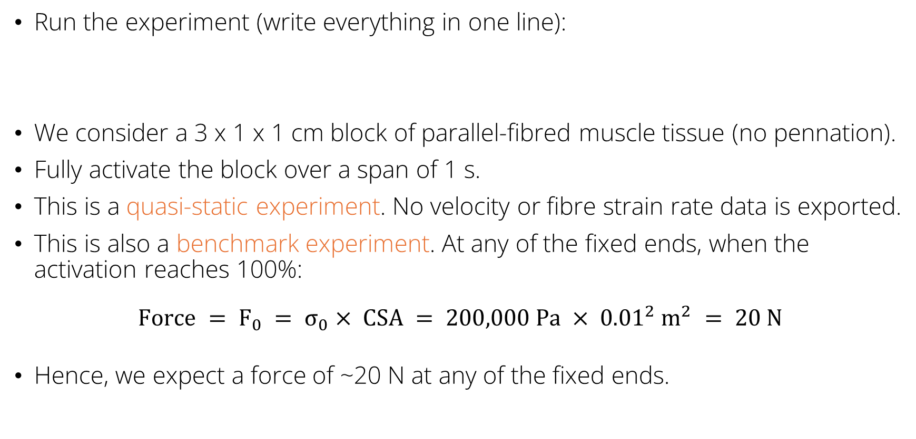
Example 1: Isometric contraction
Run the experiment (write everything in one line):
We consider a 3 x 1 x 1 cm block of parallel-fibred muscle tissue (no pennation).
Fully activate the block over a span of 1 s.
This is a quasi-static experiment. No velocity or fibre strain rate data is exported.
This is also a benchmark experiment. At any of the fixed ends, when the activation reaches 100%:
$$Force = F_{0} = σ_{0}× CSA = 200,000 Pa × {0.01}^{2} m^{2} = 20 N$$
Hence, we expect a force of ~20 N at any of the fixed ends.
./flexodeal-lite –PARAMETERS=examples/IC_parameters.prm
-BDY_STRAIN=examples/IC_strain.dat –ACTIVATION=examples/IC_activation.dat
–OUTPUT_DIR=results_ic

Slide 19
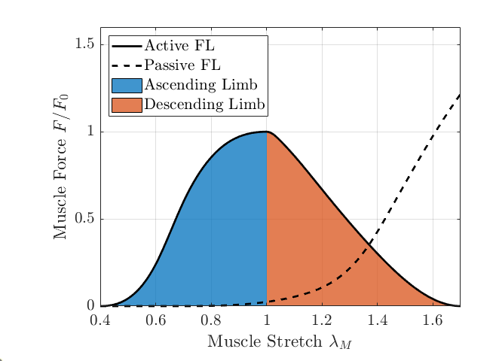
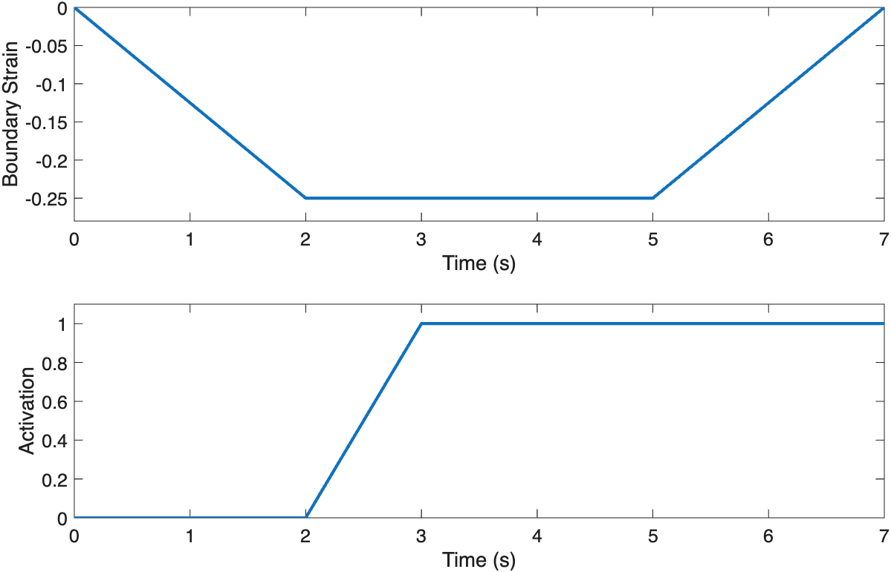
Example 2: Ascending limb contraction
Run the experiment (write everything in one line):
./flexodeal-lite -PARAMETERS=examples/AL_parameters.prm
-BDY_STRAIN=examples/AL_strain.dat
-ACTIVATION=examples/AL_activation.dat
-OUTPUT_DIR=results_al
We consider a 3 x 1 x 1 cm block of muscle-tissue, 30 deg. pennation. This is a dynamic experiment.
Strain and activation profiles:

Slide 20
Try it yourself!
Set up a contraction on the descending limb of the force-length curve as follows:
Lengthen the muscle block to 1.1 times its initial length (or +10% strain) over 2 seconds.
Then, perform an isometric contraction over 1 second, activating the muscle to 50%.
Shorten the muscle back to its initial length over 2 seconds.
You can assume the same geometry and muscle architecture as for the ascending limb contraction.

Slide 21
More Resources
Finite element simulation using deal.II: https://www.dealii.org/current/doxygen/deal.II/Tutorial.html
Mathematical details of Flexodeal:
Almonacid, J. A., Domínguez-Rivera, S. A., Konno, R. N., Nigam, N., Ross, S. A., Tam, C., & Wakeling, J. M. (2024). A three-dimensional model of skeletal muscle tissues. SIAM journal on applied mathematics, 84(3), S538-S566.
Almonacid Paredes, J. A. (2025). On the nonlinear elastodynamics of skeletal muscle (Chapters 5 and 6). PhD Thesis, Simon Fraser University (available at www.sfu.ca/~javiera).
ParaView documentation: https://docs.paraview.org/en/v5.13.1/UsersGuide/introduction.html

Slide 22












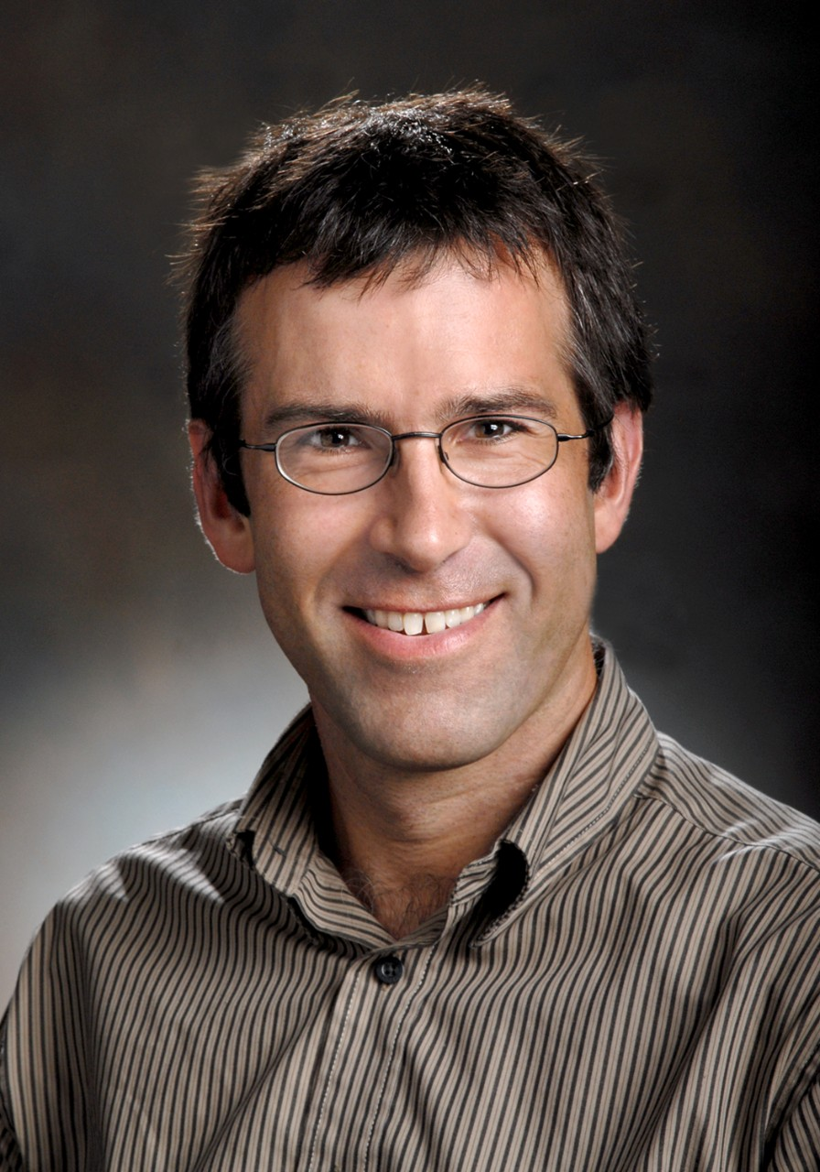
www.github.com/sfu-nml
www.linkedin.com/company/sfu-nml
Flexodeal contributors
Javier Almonacid
Harshil Pathak
Kshitij Patil
Ryan N. Konno
Cassidy Tam
Sebastian Dominguez
Stephanie A. Ross
David S. Ryan
Hadi Rahemi
Nilima Nigam
James M. Wakeling

Slide 23
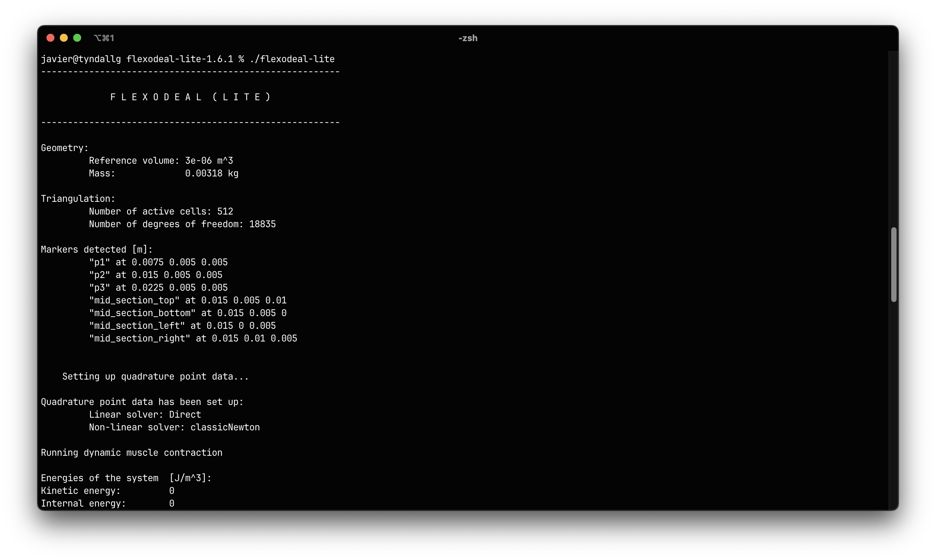
Running Flexodeal Lite
Information about your geometry (computational domain).
Information about your mesh (computational domain).
Markers are used to track displacements at selected points.
Information about the numerical solver
Whether your contraction is dynamic or quasi-static

Slide 24
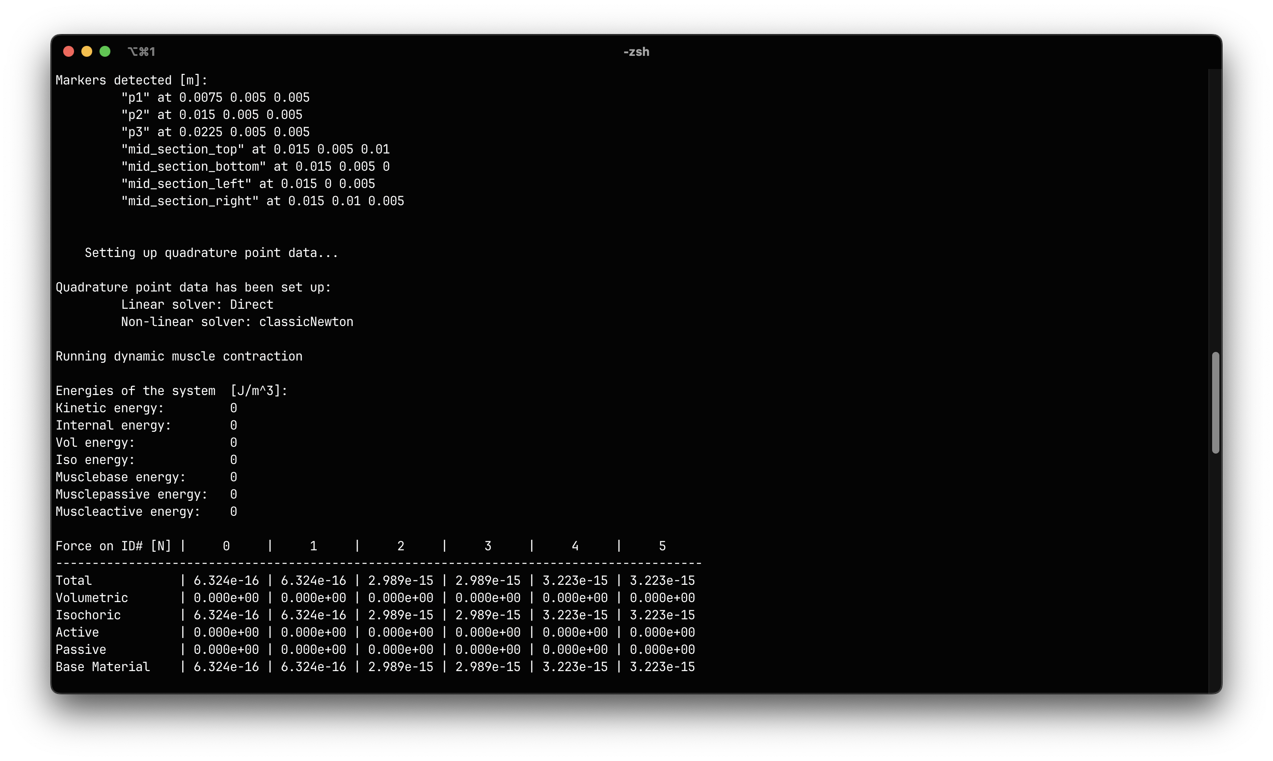
Monitoring energies and forces
Energies and forces are also available as CSV outputs!
Energies of the system at the current time step.
Force (vector magnitude) at each boundary ID at the current time step

Slide 25
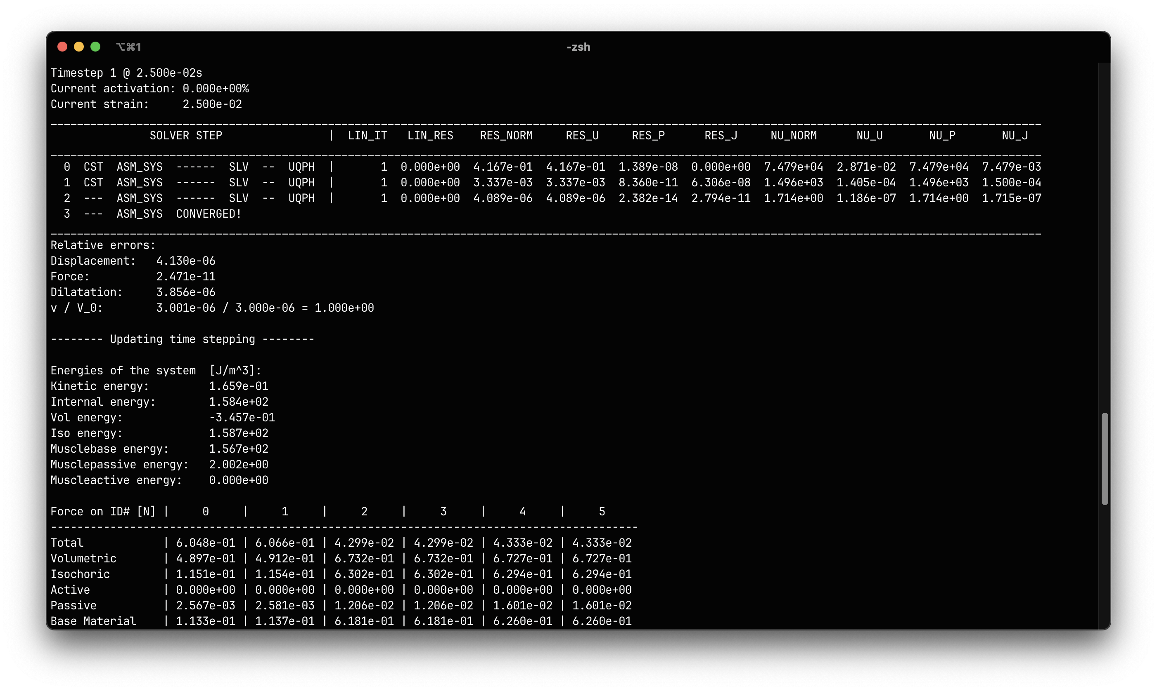
Monitoring residuals
RES_NORM:
Norm of the residual vector R(U,P,J).
RES_U: Norm of the displacement block in R(U,P,J).
NU_NORM: Norm of the Newton increment vector (ΔU, ΔP, ΔJ).
NU_U: Norm of the ΔU block.
Convergence is achieved when:
RES_U <= Tolerance force
and
NU_U <= Tolerance displacement
These tolerances are set in the parameters.prm file.

Slide 26
Monitoring residuals
Lines 1 to 3: Normalized errors in displacement, residual (force), and dilatation (J) after convergence.
Line 4: Change in muscle volume V/V_0.
Energies and forces are updated.

Slide 27
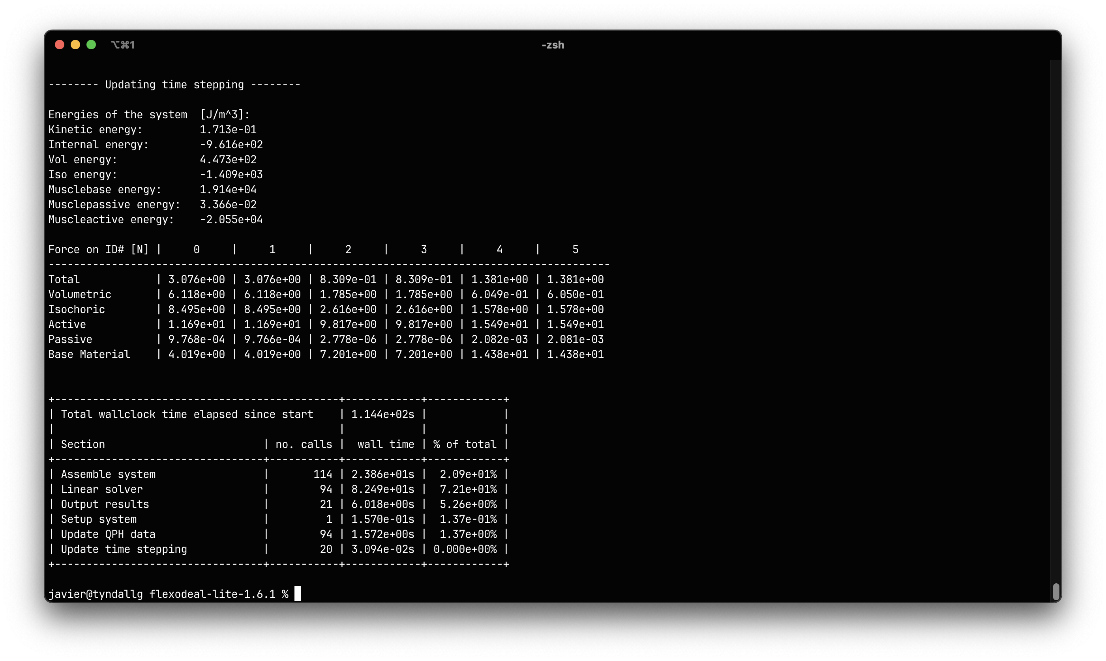
Summary of computational times
Total computational time spent in each major task.

